Slide 1
Wellness Coaching
By Wellness Alliance -January 2019

Slide 2
coaching Guidelines for health care professionals
Wellness Coach Introduction Session:
A comprehensive presentation to his client with education, work, projects achieved and in progress and main field of interest, family status
Wellness and Health are a holistic multi dimensional state

Slide 3
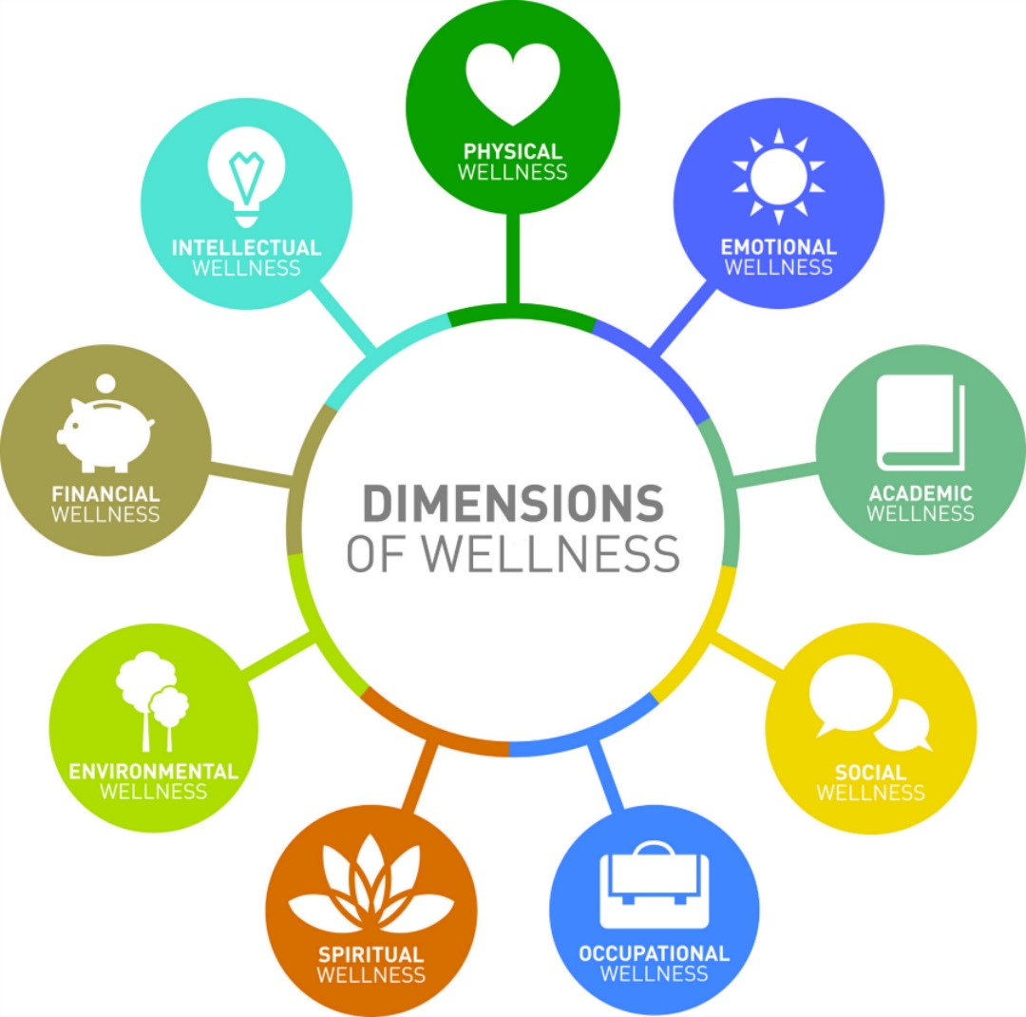
Wellness is Multidimensional
CLIENT IS ENFORCED THAT WELLNESS IS ACHIEVED THROUGH INDIVIDUAL EFFORTS FROM WITHIN AND A HOLISTIC HEALTHY LIFESTYLE
THE COACH ACOMPANIES THEM ON THE JOURNEY.

Slide 4
WHY COACHING IS SO IMPORTANT
COACHING PROCESS HELPS AN INDIVIDUAL BE MORE ACCOUNTABLE ON HIS SELF CARE, HEALTH JOURNEY AND HEALTHY ROUTINES THAT HE WISHES TO INITIATE
TO ACHIEVE A NEW ROUTINE THEY MIGHT NEED FEW MONTHS- 3 OR MORE COACHING HELPS TIL AN OBJECTIVE OR A STATE OF WELLBEING IS ESTABLISHED
COACHING SHOULD BE PLEASANT, COMFORTABLE , REWARDING AND ACHIEVE GOALS IN A LIMITED TIME
OUR COACHING GIVES TIPS ABOUT RESEARCH BASED TOOLS ON WHAT WELLNESS MEANS AND HOW TO BE ACHIEVED

Slide 5
First Session - Well-being Questionnaires
Client completes the Multi dimensional Well-being Questionnaires, privately, before the first coaching session without the obligation of sharing it to coach
Well-being Questionnaires assess client’s lifestyle and routines and cover all areas of life
Client is encouraged to share with coach what subjects he wants to clarify and work on
Key coaching skills: Mindful Listening, Open inquiry, and Perceptive Reflection
Formulate initial, strengths-based inquiries
Ask client what questions they have after completing the well-being assessment
Ask client what insights they may have had by completing the well-being assessment

Slide 6
Well-being Questionnaires- Wellness assessment 1
Physical Wellness Emotional Wellness Social Wellness Spiritual Wellness
Financial Wellness Intellectual Wellness Occupational wellness Environmental Wellness
Personalized Wellness Goals: Reflect about your wellness routines and create some new questions of your own
Personalized Wellness Goals Based on the above, which are the topics you are passioned in exploring more ?
and would like to focus during the following months?
Write one or two !Then create a goal or an activity for each one! Good luck!

Slide 7
Physical Wellness
List your favorite physical exercises- activities
Write what stretching and balance exercises you practice if any
Think about which are your tips for a healthy sleep
Write what fruits and vegetables you take with your regular snacks and meals
Think about your fasting of animal fats and meat

Slide 8
Emotional Wellness:
List
List the activities that relax you
Meditate about
Meditate about the music you like
Reflect about
Reflect about what makes you feel pleasant
Write about
Write about happy things and people who make you happy

Slide 9
Social Wellness
Reflect about ways you can express your gratitude and support to friends and close groups
What social circumstances benefit you the most ?
What makes your relations great ?
List social activities you are involved in, to better the community and the world

Slide 10
Occupational Wellness
Is you office an ergonomic space ?
Describe in what environments you are most productive
What habits bring you the most productivity and make you feel in charge?
What are your well-being routines you have during your day

Slide 11
Financial Wellness
Reflect how you can attract abundance,
how are you generally most easier getting your money
Focus and write about how you can avoid wastes
Do you invest in charitable projects
List ways you can increase your financial knowledge

Slide 12
Environmental Wellness
Reflect about the environmental projects you have involved or would like to involve
1
Create -develop one of your own that you feel passionate of
2

Slide 13
Intellectual Wellness
What networking activities benefit you? How can you benefit the most of them?
What authors, books, blogs are inspiring?
What activities benefit exploring?

Slide 14
Spiritual Wellness
Describe what spiritual practices benefit you on a daily basis
1
How can you make your life well lived , meaningful and happier ?
2

Slide 15
First Session - CREATE A WELLNESS VISION
Explain the value of creating a wellness vision: A vision is a compelling statement of who you are and what
health-promoting, life-giving behaviors you want to do consistently.
Ask about strengths and current successes: What are you currently doing to support your health and
wellbeing? What elements of your life do you feel best about? In what way did you contribute to making
those true/possible?
Collaborate to identify the client strengths: What are your success stories? What gives you pride? What
qualities do you most appreciate about yourself?
Ask what is most important to the client right now: Given all that is going well, what are you wishing
for? What elements of your health and wellbeing do you want to improve?

Slide 16
First Session-client past successes & motivators
Discover the client’s motivators: What are the benefits of making changes now? What is the driving force
behind the desire to change now?
Support the client in visualizing their vision and describing it in detail: What are the most important elements
in your vision? Tell me what your vision looks like. Paint me a picture. What would you look and feel like at
your ideal level of wellness? What kind of person do you want to be when it comes to your health and
wellbeing?
Discover previous positive experiences with elements of the vision: What have been your best experiences to
date with the key elements of your vision, times when you felt alive and fully engaged? Tell one or two stories,
in detail.

Slide 17
First session – client strengths
Identify the strengths and values that could be used to reach the vision:
What do you value most about your life? What values does your wellness vision support?
What strengths can you draw on to help you close that gap and realize your vision? How can the lessons from your successes in life carry over to your current situation?

Slide 18
First session – client support system
What people, resources, systems, and environments can you draw on to help you realize your vision ?
What strategies may be effective to help you realize your vision and meet your challenges?

Slide 19
First session - Client challenges
What challenges do you anticipate having to deal with on the way to reaching your vision?
What concerns you most?

Slide 20
First session First draft statement
Reflect and summarize what you have heard the client saying about their vision. Collaborate on a first draft statement that captures their vision in a way that is meaningful and compelling for them.
Ask the client to state and commit to the vision.

Slide 21
First-OR FOLLOW UP session – DESIGN 1-year – 6-month 3-MONTH GOALS
Brainstorm actions that would lead to the achievement of the wellness vision
Ask the client to choose 3 actions that are most important to pursue
Confirm the connection of the actions to the wellness vision
Assist the client in translating the actions into SMART behavioral goals

Slide 22
First session - DESIGN FIRST WEEK’S GOALS
Ask the client to choose a goal that is important
Explore the structures (people, resources, systems, and environments) needed to ensure success
Assist the client in designing a SMART behavioral goal: specific, measurable: achievable, relevant, time related
Use confidence ruler to improve the client’s confidence in reaching the goal
Ask client to restate the goal
Affirm the client’s ability to achieve the goal

Slide 23
SESSION CLOSE
Express appreciation for the client’s work
Ask for feedback on how future coaching sessions would best support the client’s path
Schedule the next session

Slide 24
REGULAR FOLLOW UP SESSION -Session Opening
Asks how the client is right now, “in this moment”
Asks the client to share the best thing that happened from previous week(s)
Reflects something positive about the client (e.g., highlights, strengths, or emotions)
Asks client to select the first weekly goal to be discussed

Slide 25
FOLLOW UP SESSION - Weekly Goal Review
For each of two goals:
Explores full experience with weekly goal, starting with the positive
Expands inquiry about the client’s best experience with his/her weekly goal
Asks what the client learned from his/her experience
Affirms the client: strengths, choices, and/or situation
Inquiries about the client’s percentage of success

Slide 26
FOLLOW UP SESSION -3-Month Goal Review
Validates the relevance of the client’s Wellness Vision and connection to three month goals
Asks about the client’s best learning or growth experience with his/her three-month goals
Asks about the client’s level of commitment with his/her goals and whether s/he wants to revise them
Affirms the client’s strengths, abilities, or growth

Slide 27
FOLLOW UP SESSION- Generative Moment
Collaborates with the client to identify the topic to work on, where s/he has aroused emotional energy and interest
Asks for permission to explore and work with the topic now
Encourages the client to imagine what s/he really wants now, in relation to the topic
Explores the strengths and values the client can leverage to move forward

Slide 28
FOLLOW UP SESSION- Generative Moment
Explores the environments the client can leverage to move forward
Explores decisional balance and develops discrepancy when the client demonstrates ambivalence
Engages the client in creative brainstorming of pathways forward
Expresses confidence in the client’s ability to move forward

Slide 29
FOLLOW UP SESSION- Generative Moment
Explores the environments the client can leverage to move forward
Explores decisional balance and develops discrepancy when the client demonstrates ambivalence
Engages the client in creative brainstorming of pathways forward
Expresses confidence in the client’s ability to move forward

Slide 30
FOLLOWING Weekly Goal Setting
For each of two goals:
Asks the client to choose a goal that is important and s/he is ready to pursue o
Explores the support needed to ensure success and handle challenges, such as relationships, environments, structures, and routines
Assists the client to refine goal to be a SMART behavioral goal
Asks the client to restate the goal

Slide 31
Session Close
Communicates an appreciation of the client’s work during the session
Discovers and reflects what the client learned in the session
Asks for feedback on how future coaching sessions could best support the client’s path
Schedules next session

Slide 32
RESEARCH BASED RECOMMENDATIONS FOR IMPROVEMENT OF ALL OF LIFE AREAS
PHYSICAL: HEALTHY EATING GUIDELINES: FOCUS ON RAW, VEGETABLES-FRUITS-BEANS AND NUTS- BREADS- SOME MEAT, DIARY, ORGANIC ,FRESH FOODS, FASTING OF MEAT, PLENTY OF WATER , MINIMAL SALT, MODERATE ANIMAL FATS
PHYSICAL : REGULAR PHYSICAL ACTIVITY OF MODERATE LEVEL, FAVORITE
PHYSICAL AND EMOTIONAL : ACCESSING COMPLEMENTARY MEDICINE
EMOTIONAL – DEDICATING TO WORK OF INTEREST, PASSION ; INTENTIONAL LIFE , PURPOSE ORIENTED; SOCIAL ACTIVITIES; RELAXATION; ART, MUSIC ; POSITIVE EMOTIONS;

Slide 33
RESEARCH BASED RECOMMENDATIONS FOR IMPROVEMENT OF ALL OF LIFE AREAS
EMOTIONAL:
GRATITUDE JOURNAL,, MEDITATION ,MARRIAGE
AND STABLE RELATIONSHIPS, HEALTHY RELATIONSHIPS, COUNSELLING, AVOIDANCE OF STRESSORS
01
INTELLECTUAL :
ONGOING LEARNING EXPOSURE, SEMINARS, HIGH PERFORMANCE TIPS, TIME MANAGEMENT,ORGANIZATIONAL SKILLS,
02
INTELECTUAL:
CLASSICAL MUSIC ,MEDITATION FOR FOCUS ,CREATIVITY,
EXPERIENTIAL, NETWORKING
03
FINANCIAL:
LEARNING AND NETWORKING
04
SPIRITUAL:
HELPING OTHERS, VOLUNTEERING, ENGAGING IN ENVIRONMENT ACTIONS, PRAYER, MEDITATION, FELLOWSHIPS
05
SPIRITUAL:
WELLNESS -HAPPINESS AND RELATIONSHIPS ORIENTED
06

Slide 34
copyright
All the concepts presented here are the intellectual property of Wellness Alliance Inc.
1
• –They are inspired of own nursing scholar work
and Wellcoaches Coaching Guidelines,
2
If your company uses any concept presented here, which will be a reason for your inspiration please grant Wellness Alliance Inc. copyright
3
Wellness Alliance encourages to be consulted at the implementation of the concepts presented here, with the aim of making its wellness vision as complete as possible.
4

Slide 35
Author –Founder CEO, Wellness Alliance- Education Roxanne Marin
BS Mathematics- University of Bucharest
Christiana School of Nursing - Bucharest
BS Nursing - from the University of North Carolina in Charlotte
Master Nursing Studies - from Winston Salem State University
Positive Psychology Course for Medical Professionals --Wellness Coaching- Wellcoaches
Wellness Introduction Course - The Health and Wellness Program - Arizona State University
Introduction Course in Positive Psychology - Chapel Hill University, North Carolina Coursera - Prof. Barbara Frederickson
Introduction to Health and Wellness - University of Berkeley - Science of Happiness,
Forum of Functional Medicine & Webinar - Institute of Functional Medicine
Seminar of Integrative Medicine - Mind and Body Medicine - University of Miami –and others

Slide 36
Author Roxanne Marin Activity
experience over 15 years in education –and 8 years in medical care for acute and chronic conditions such as advanced cardiovascular disease, diabetes, muscle, bone, kidney, cancer, wounds, rehabilitation, palliative
collaboration with community medical clinics -NC- for poor populations with health coaching services and development of holistic educational materials
recommendations on wellness promotion measures in community medical clinics, schools, colleges, universities and churches

Slide 37
Contact
Wellness Alliance Inc –non profit
Charlotte, North Carolina
Wellness Alliance Inc
SRL-D Bucharest Romania, 43 Emanoil Porumbaru Street, Sector 1
E mail: wellnessalliance.us@gmail.com
Roxanne Marin,
Nursing , Holistic Wellness Founder & CEO Wellness Alliance Bucharest, sect 1, Romania,
Charlotte, North Carolina

